Slide 1
Chongqing University of Technology
ATAI
Advanced Technique of Artificial Intelligence
Chongqing University of Technology
Semantic and Syntactic Enhanced Aspect Sentiment Triplet Extraction
(ACL-2021)
Reported by Ling Zhu

Slide 2
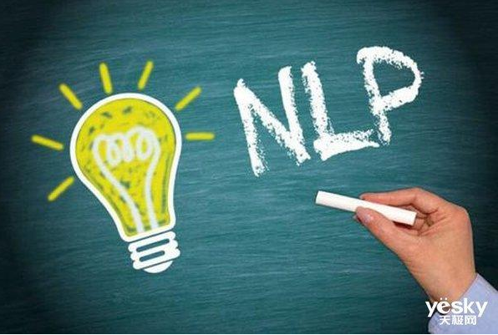
Chongqing University of Technology
ATAI
Advanced Technique of Artificial Intelligence
Chongqing University of Technology
Introduction
Motivation
Approach
Experiments
Conclusion

Slide 3
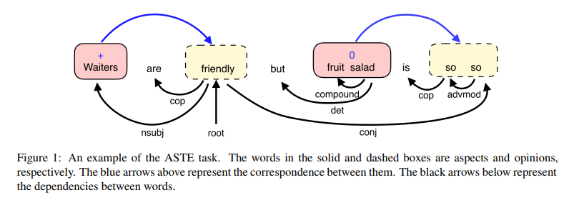
Introduction
(Waiters; friendly; +) and (fruit salad; so so ; 0)
(aspect, opinion, sentiment)
where we use +, -, and 0 to represent positive, negative, and neutral sentiment.
New task
2020AAAI——Knowing What, How and Why: A Near Complete Solution for Aspect-Based Sentiment Analysis
Aspect Sentiment Triplet Extraction（ASTE）

Slide 4
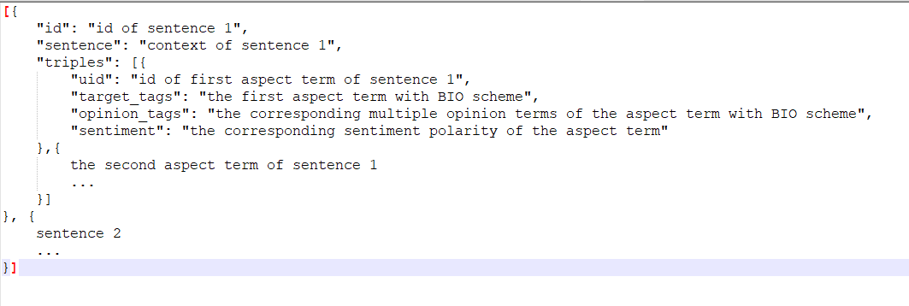
Approach
Eg.

Slide 5
Motivation
Past method cannot effectively establish the connection between words and ignore the semantic and syntactic relationship between the three elements
Current solutions either fail to capture these one-to-many relationships
a sentence may contain a one-to-many case, that is, one aspect corresponds to multiple opinions, or one opinion corresponds to multiple aspects. For instance, in the sentence ”We love the food, drinks, and atmosphere,” the opinion ”love” is associated with three aspects “food”, “drinks”, and “atmosphere”.

Slide 6
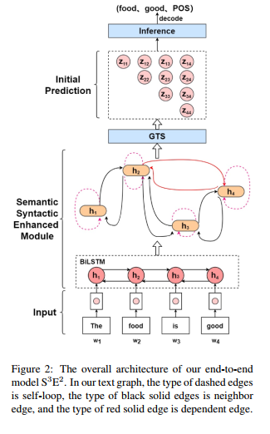
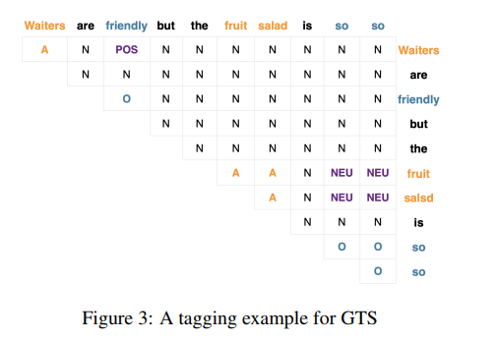
Approach
Notes:
Grid Tagging Schema
2020-EMNLP-Grid Tagging Scheme for Aspect-oriented Fine-grained Opinion Extraction

Slide 7
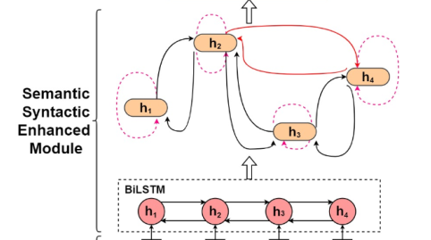
Approach
Semantic and Syntactic Enhanced ASTE Model
Graph-Sequence Duel Representation
G = (V; E),V is set of each word
three types of edges: self-loop edge, neighbor edge, and dependency edge
Self-loop edge: there is an edge connecting to the node itself.
Neighbor edge: the edge connecting a node and its neighbor.
Dependency edge: there exists a dependency relationship between two nodes.
GraphSAGE (2017NIPS-Inductive representation learning on large graphs)

Slide 8
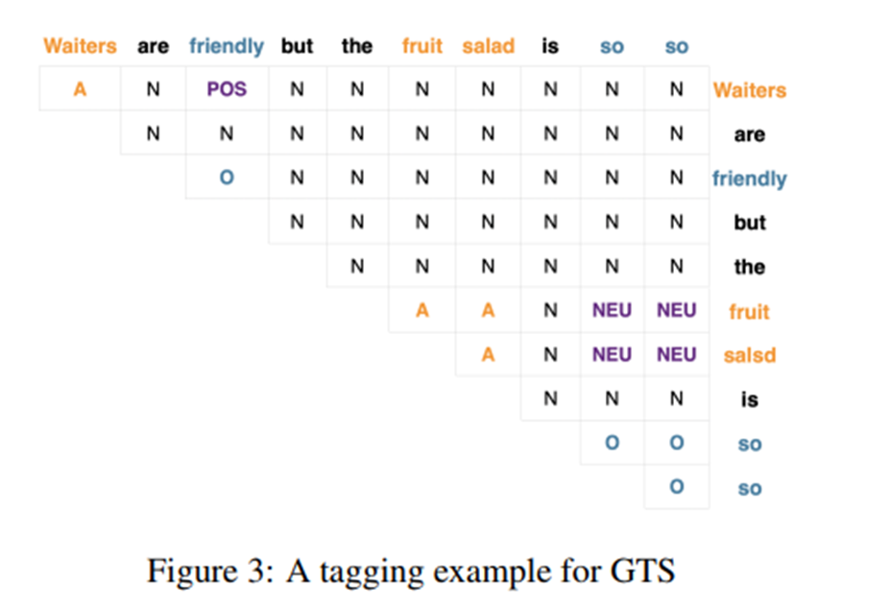
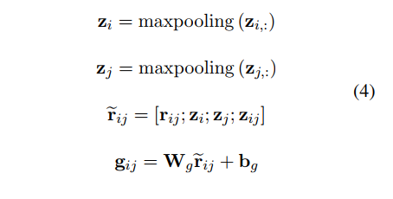
Approach
Semantic and Syntactic Enhanced ASTE Model
Inference Strategy
is upper triangular grid in GTS
$$z_{ij}=w_{i}/w_{j}$$

Slide 9
Experiments

Slide 10
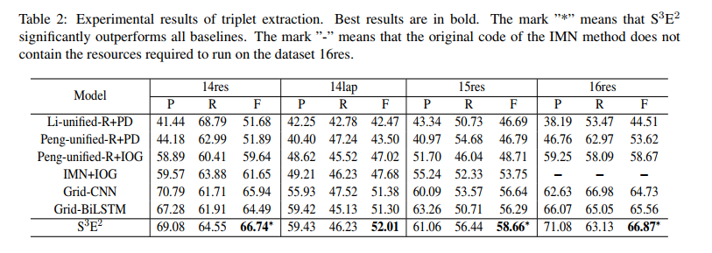
Experiments

Slide 11
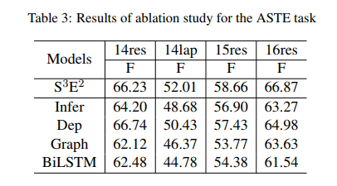
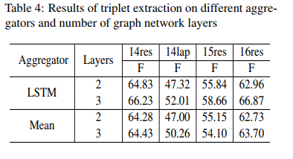
Experiments

Slide 12
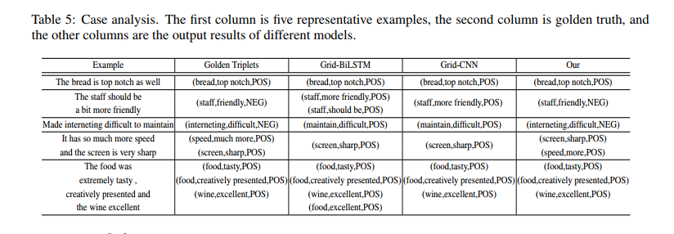
Experiments

Slide 13
Thanks

